Slide 1

Harassment

Slide 2
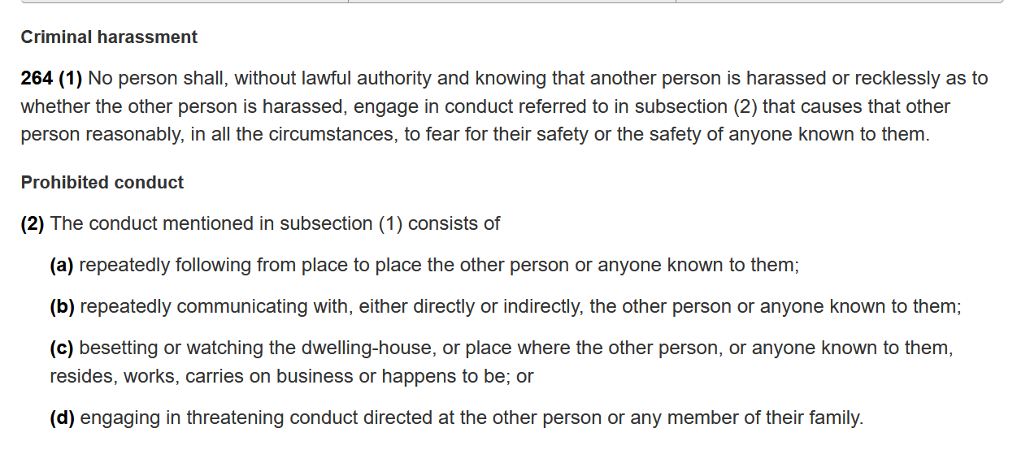
Harassment vs. Criminal Harassment
Harassment: aggressive pressure and/or intimidation (OED)
Criminal Harassment:

Slide 3

Different types of harassment
Intimate partner/dating
Acquaintance
Stranger

Slide 4
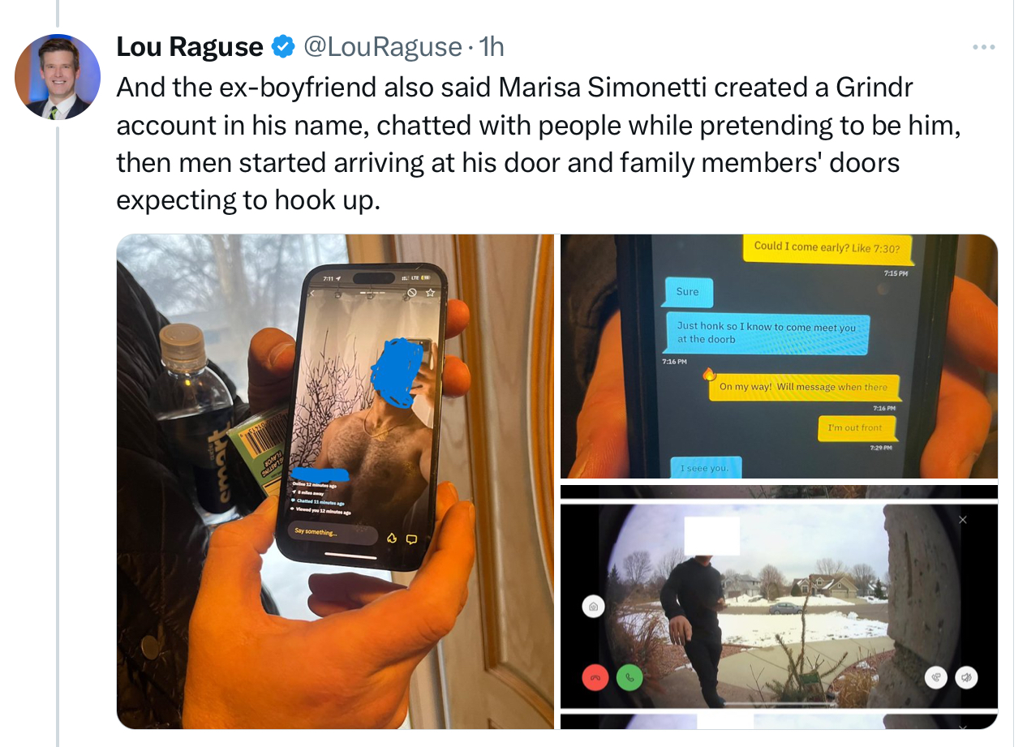

Slide 5
Dating-related Stalking and Harassment (Rothman et al. 2021)
Youth (12-18) with dating experience were asked whether a dating partner had ever spied on or followed them, damaged something that belonged to them, or gone through their online accounts.
What they found:
The prevalence of lifetime stalking and harassment victimization was 48%

Slide 6
Acquaintance stalking (Logan 2023)
A study of acquaintance stalking victims found:
women who experienced online monitoring endured threats, life interference, sexual harassment, stalker jealousy, and control issues.
Women who experienced online monitoring had higher fear levels, reported more problems during the stalking, and had increased resource losses compared to the other two groups.

Slide 7
Acquaintance stalking (Logan and Landhuis 2023)
Researchers asked acquaintance stalking victims (women) about their experiences.
Here’s what they had to say:

Slide 8
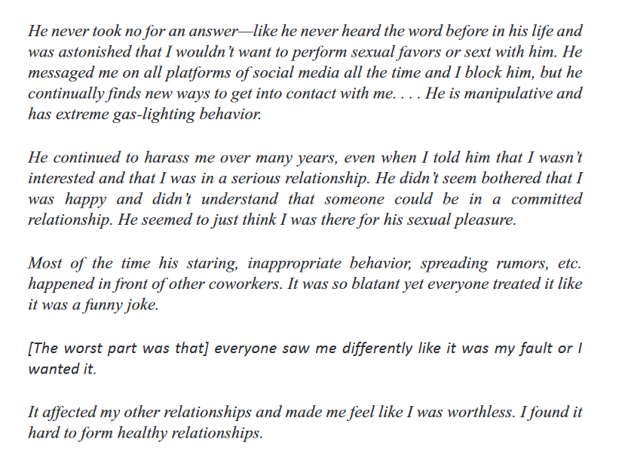

Slide 9
Coping strategies victims use (Podana and Imríšková 2016)
proactive behavior (47% of victims): meeting the offender face to face, reporting stalking to the police, seeking professional or informal help, and a change of address.
avoidance (30%):changed their usual activities or way home/way to work
passivity (23%): either changed nothing about their behavior, or they just ignored the offender
Passivity is linked to “freezing”

Slide 10
Freezing
freezing is a response to a threat that is characterized not only by immobility but also by inhibition of behavior. 3 types:
Detection freezing: this occurs when a victim, who thought things were ‘normal’, suddenly realizes they’re being threatened. Lasts a few seconds E.g. Massage that turns sexual.
Stopped thoughts/behaviours: a victim’s thoughts and behaviours stop for a few seconds. Victim is processing what’s happening
Shocked freezing: typically described as ‘going blank’. Victims are incapable of responding. Lasts for longer and typically leaves victims feeling completely helpless.

Slide 11
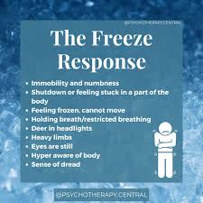

Slide 12
Why does freezing happen?
Freezing is a common and natural survival reaction which is activated by the brain when a person feels extreme threat.
We can think of it as a survival reaction (reflex) that occurs when all other options to avoid threat have been exhausted or the individual feels overwhelmed and helpless.
I REPEAT: THIS IS S COMMON AND NATURAL PHENOMENON

Slide 13

Testing what people do vs what they think they’ll do when faced with harassment
In 2001, two researchers designed a set of clever experiments to test the extent to which people over-estimate the extent to which they would ‘fight back’ or defend themselves in a harassment situation.

Slide 14
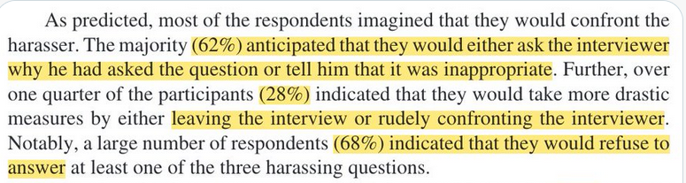
Study 1 (Woodzicka and LaFrance 2001) :
Researchers first asked young women to IMAGINE how they would feel if asked sexually intrusive questions in an interview: "Do you have a boyfriend?" "Do people find you desirable?" "Do you think it's important for women to wear bras to work?"

Slide 15
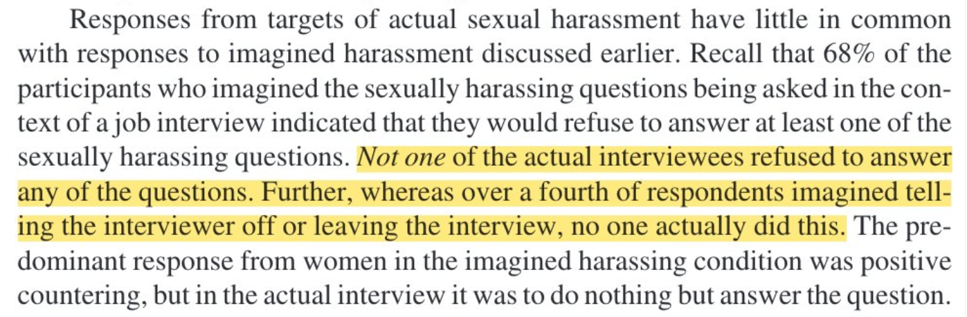
Study 2: (Woodzicka and LaFrance 2001).

Slide 16
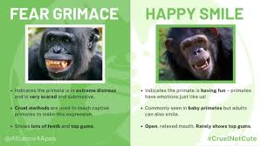
More on freezing:
While women imagined they'd be outraged and confront the interviewer, when actually being harassed, the majority (52%) froze and did nothing.
No one quit the interview
Many smiled politely during the questions (a form of appeasement)
No one even reported the harasser

Slide 17

Stranger harassment

Slide 18

Lisa-Michelle Kucharz’s story
In 2014, Lisa-Michelle became the target of a cyber-stalker.
For 16 months, she was the victim of harassing, threatening emails, fake facebook pages and posts, etc.
At first, Lisa-Michelle withdrew from social media, then she decided to fight back.
She hired a private investigator and identified her stalker.
It was a Canadian woman who was dating someone who Kucharz had previously dated.
The woman was reported to authorities and sentenced to 6 months in jail.

Slide 19
Kucharz’s safety-tips
1. Resist the urge to respond and block the harasser. Don’t engage, respond, retaliate or share your harassers' statements
2. Document everything — Preserve the evidence and the context from meetings with school officials, police officers or anyone else you may have received help from
“For static images, screenshots with full URLs are the best. If you’re on the go, on your phone or otherwise can’t get the full URL, then any screenshot is better than none. For videos or audio, do your best to capture them and include the full URL. Sort your documents and folders. Find a naming convention that is consistent and makes finding documents easy. Regularly place your files into the folders. Save your documentation in multiple locations like a computer external hard drive.”

Slide 20
3. Your safety is your priority
“If you think your life or physical well-being is in immediate danger, call law enforcement. If you’re on campus, call the University Police Emergency line. If you’re off campus, call 911.”
4. Consider consulting a lawyer with expertise in this specific area about your legal options
5. After you document an incident, inform the platform about abusive content
“Don’t give up if the platform’s initial response is unhelpful. I had to report the abuse of content multiple times and enlist my friends to do the same until it was removed.”

Slide 21
6. Be organized (and proactive) - Inform a small group of friends or family. Consider counseling. Practice self-care. Consider informing your employer. This was very helpful in my case, not only for my safety and my colleagues’ and students’ safety but also to prevent them from being surprised when contacted by my harasser or when they saw defamatory posts or comments.”
7. Set up Google Alerts to inform you if information about you is being posted online
8. Consider purchasing domains of your name and variations of it to prevent anyone else from purchasing them. You don’t have to build websites on them to own them.

Slide 22

*all done!*

